Slide 1
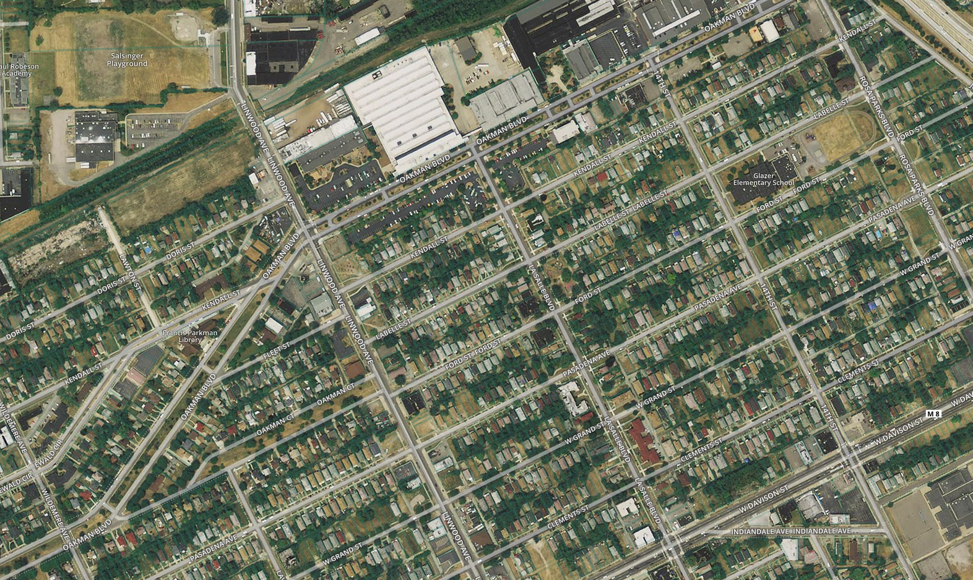
HOPE Village Eco-D and Inner Circle Greenway Plan
Disclaimer: The views and opinions expressed here are those of the authors and do not necessarily reflect the official policy or position of the Focus: HOPE organization or it’s HOPE Village Initiative partner organization. Assumptions made within the recommendations and feasibility studies do not reflect those of Focus: HOPE.

Slide 2
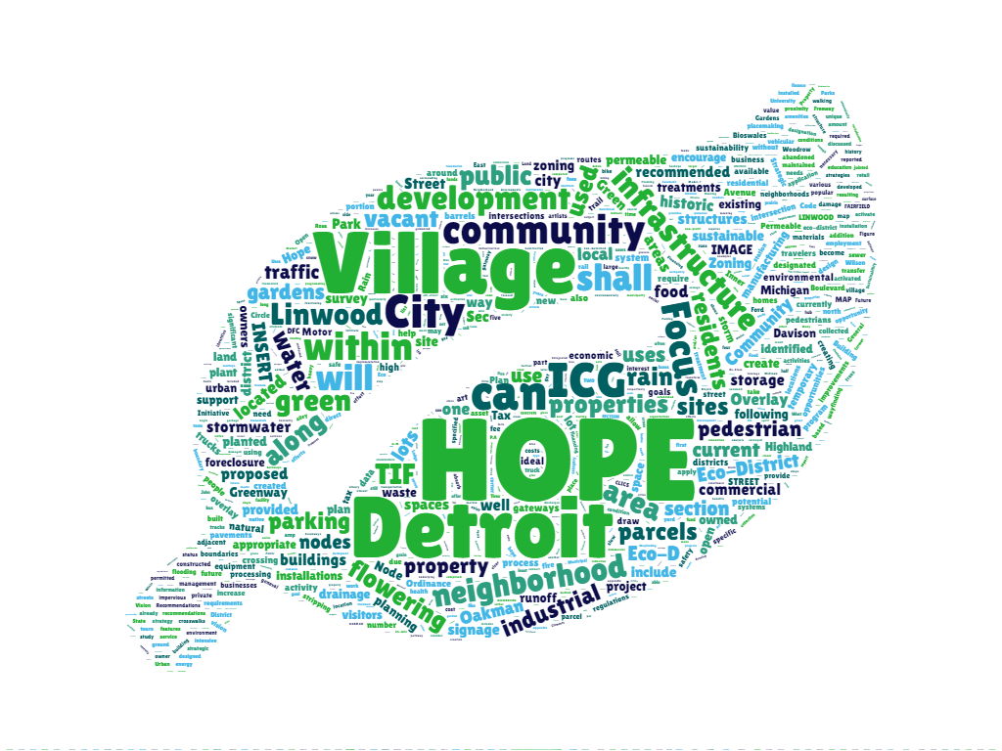
“leverage the Eco-D designation and proposed ICG development to create a vibrant, equitable and sustainable, community, today and for generations to come”

Slide 3
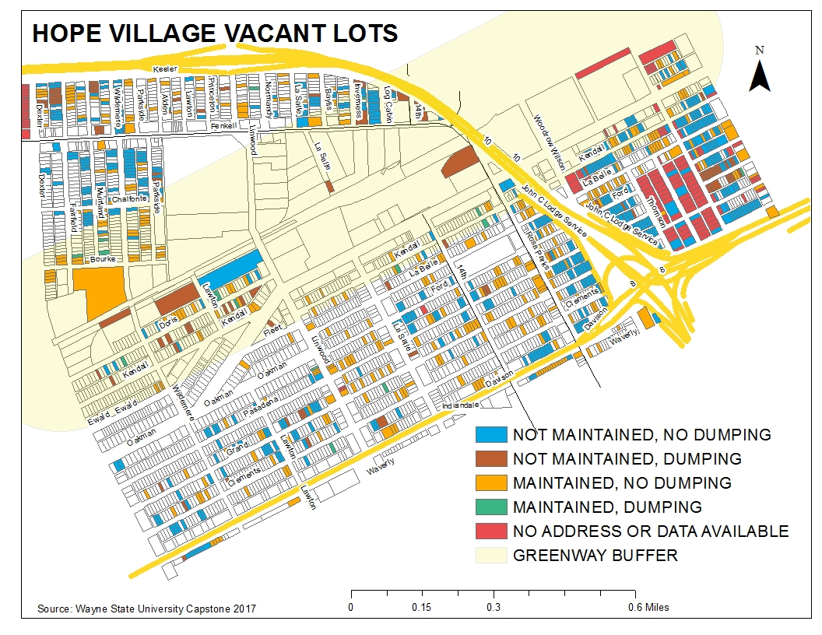
Greenway Buffer: Represents a ½ mile radius around the proposed Inner Circle Greenway located in Hope Village

Slide 5
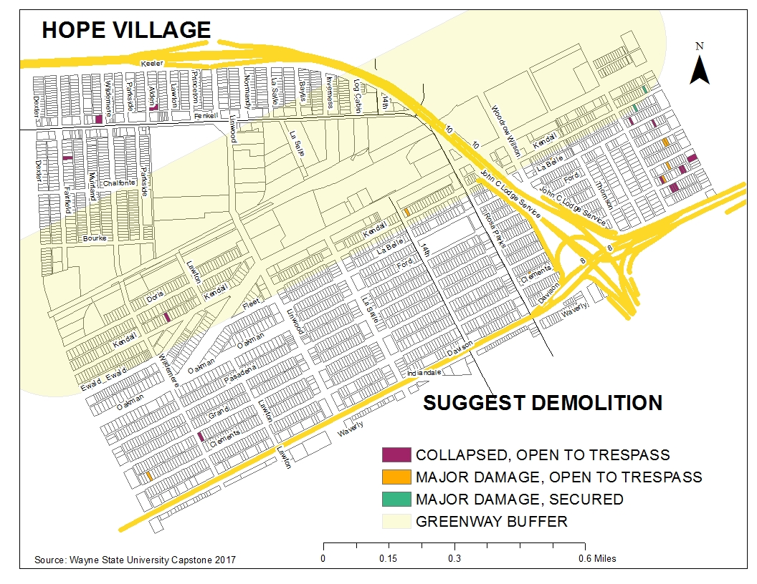

Slide 7
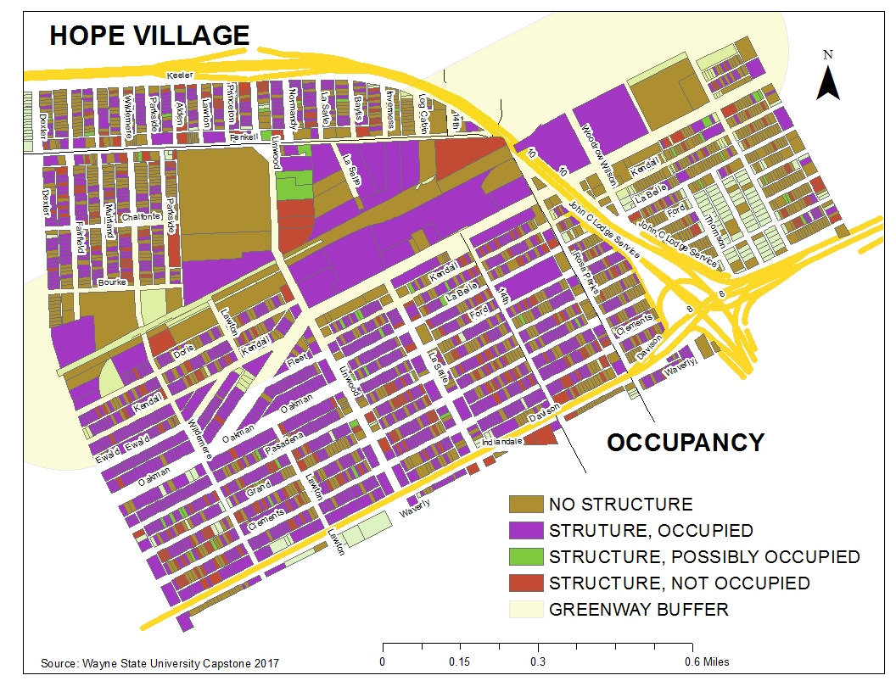

Slide 9
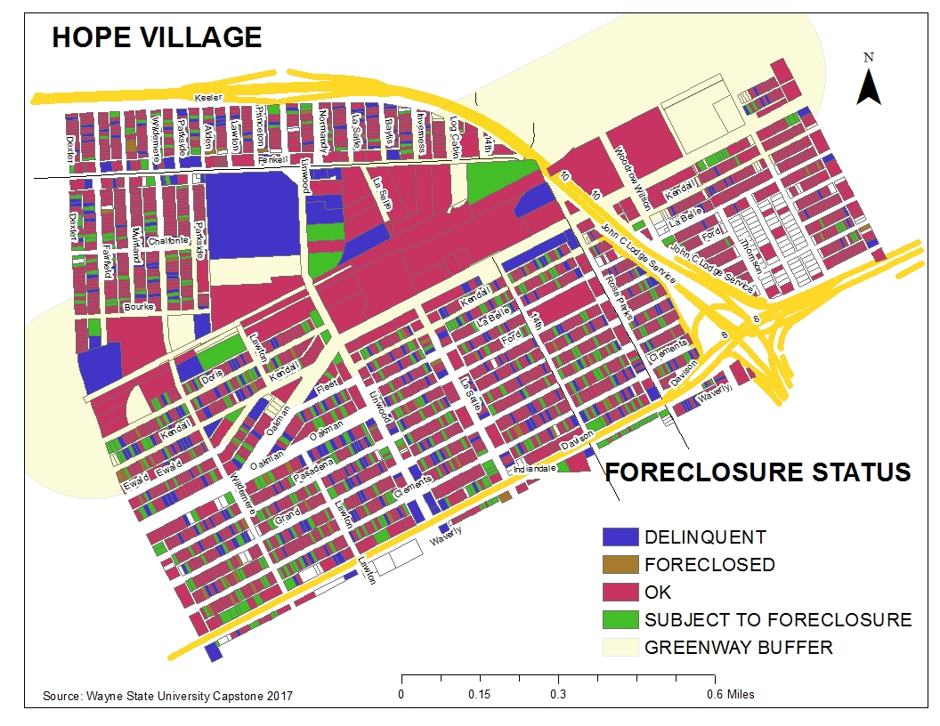

Slide 11
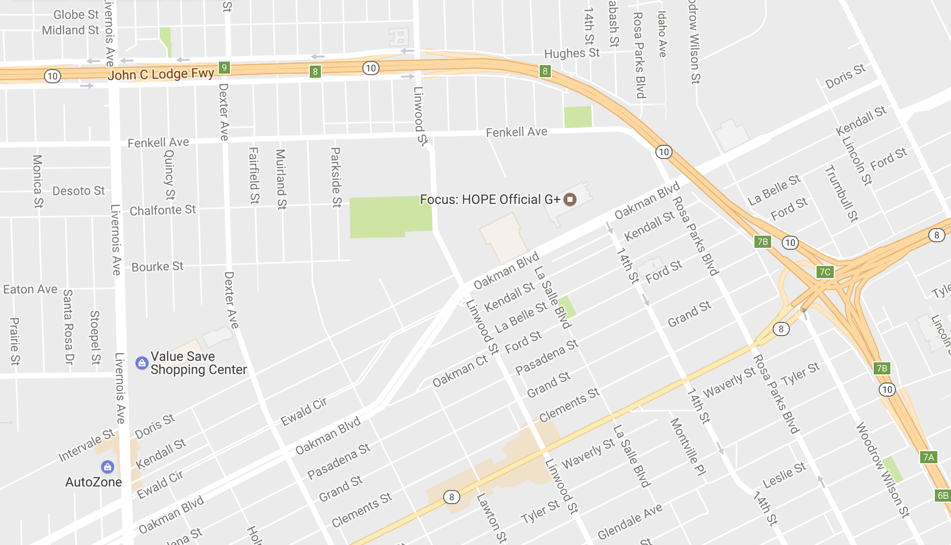
Creating Nodes: Bus Routes
Inner Circle Greenway
Linwood #29
Fenkell #18
Dexter #16
Schoolcraft #43
Inner Circle Greenway
Chicago/Davison #15

Slide 12
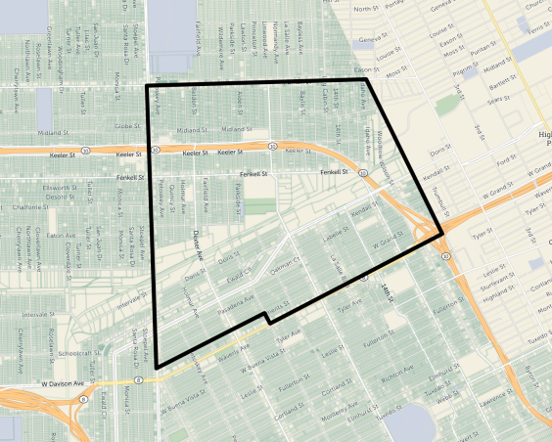
Node #1:
Linwood at
Oakman
Privately Owned
Privately Owned – Foreclosed or Delinquent
City Owned
Focus: Hope Owned

Slide 13
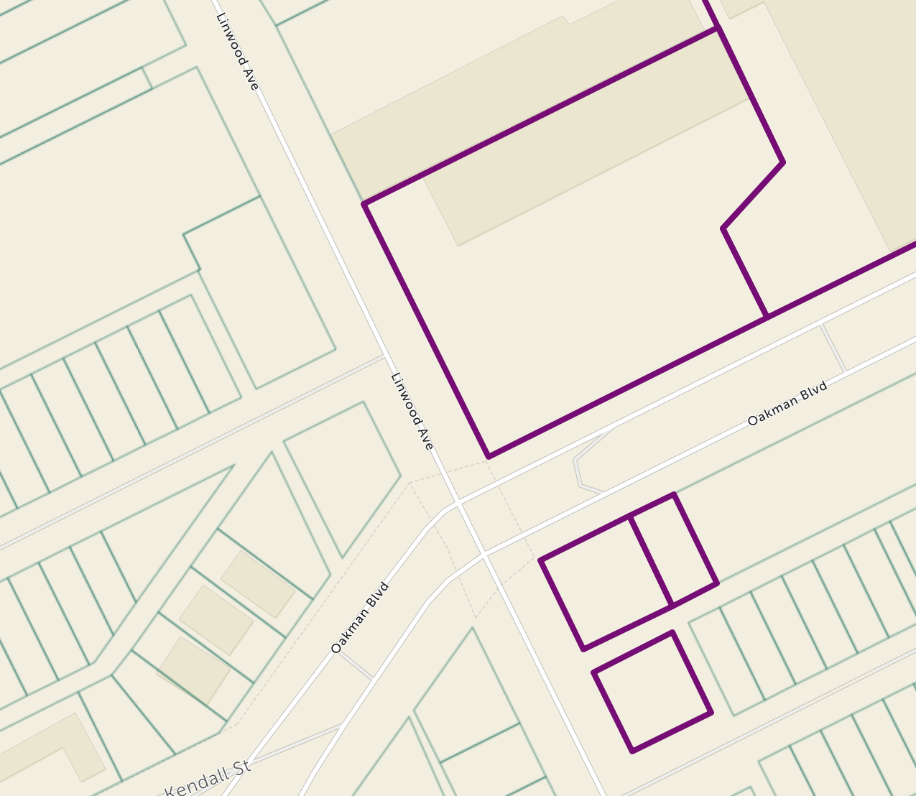
Node #1:
Linwood at
Oakman
Privately Owned
Privately Owned – Foreclosed or Delinquent
City Owned
Focus: Hope Owned

Slide 14
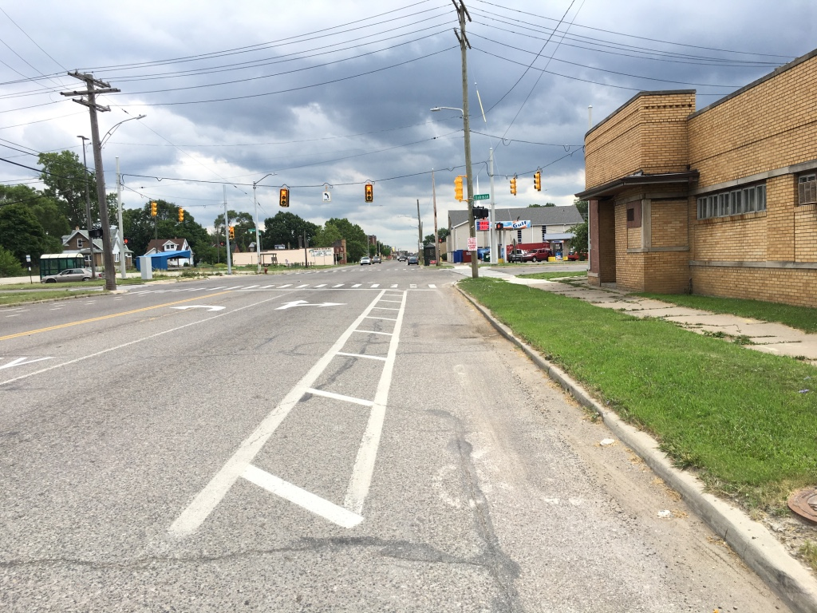
Node #1
14301 Linwood

Slide 15
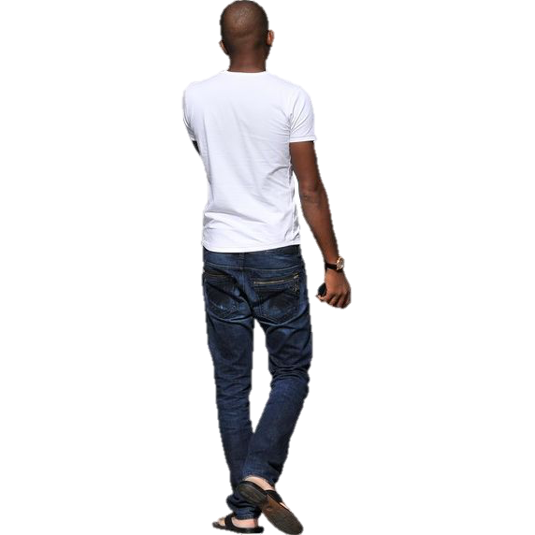
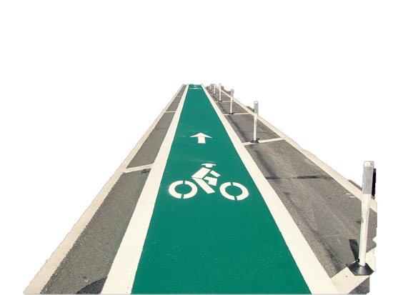
Node #1
14301 Linwood
Commercial Redevelopment
Outdoor Seating
Combine with bike infrastructure
Motor City Match to find tenants

Slide 16
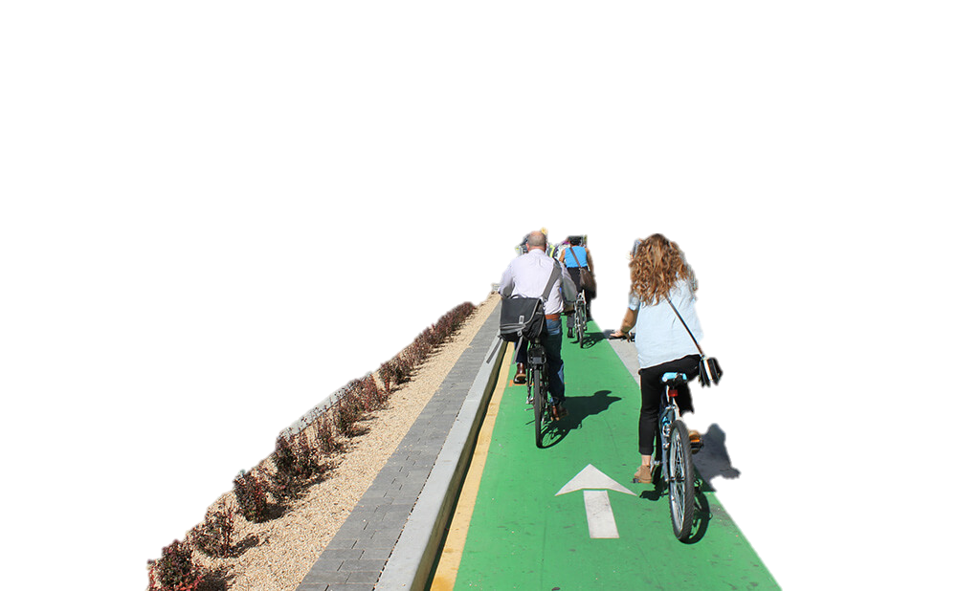
Node #1
14301 Linwood
Commercial Redevelopment
Outdoor Seating
Combine with bike infrastructure
Motor City Match to find tenants

Slide 17
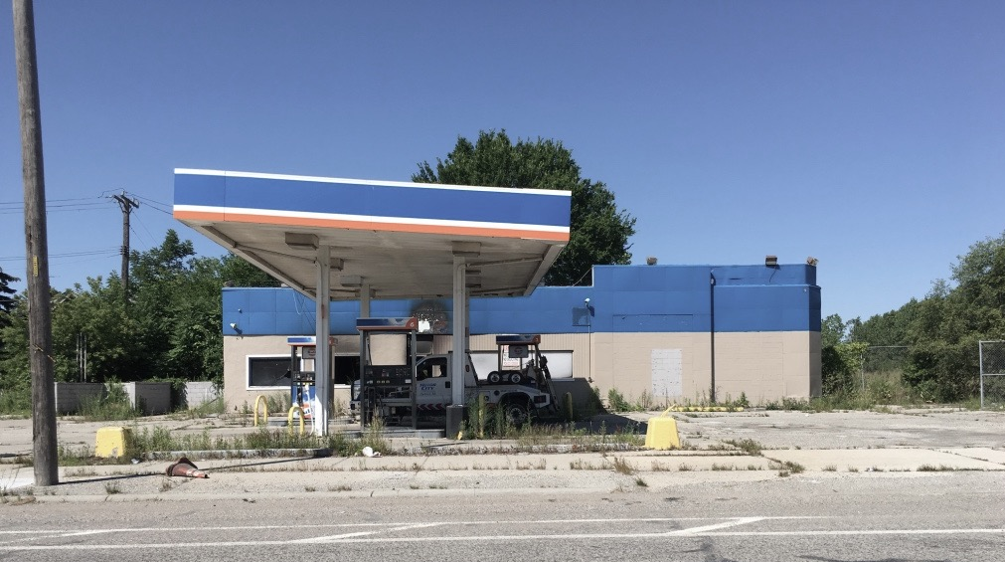
Node 1
14403 Linwood

Slide 18
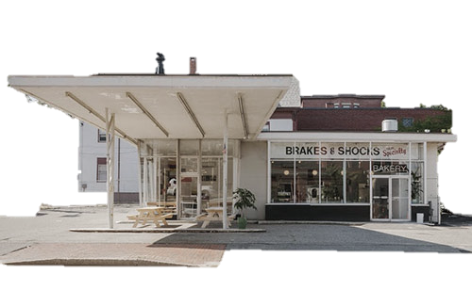
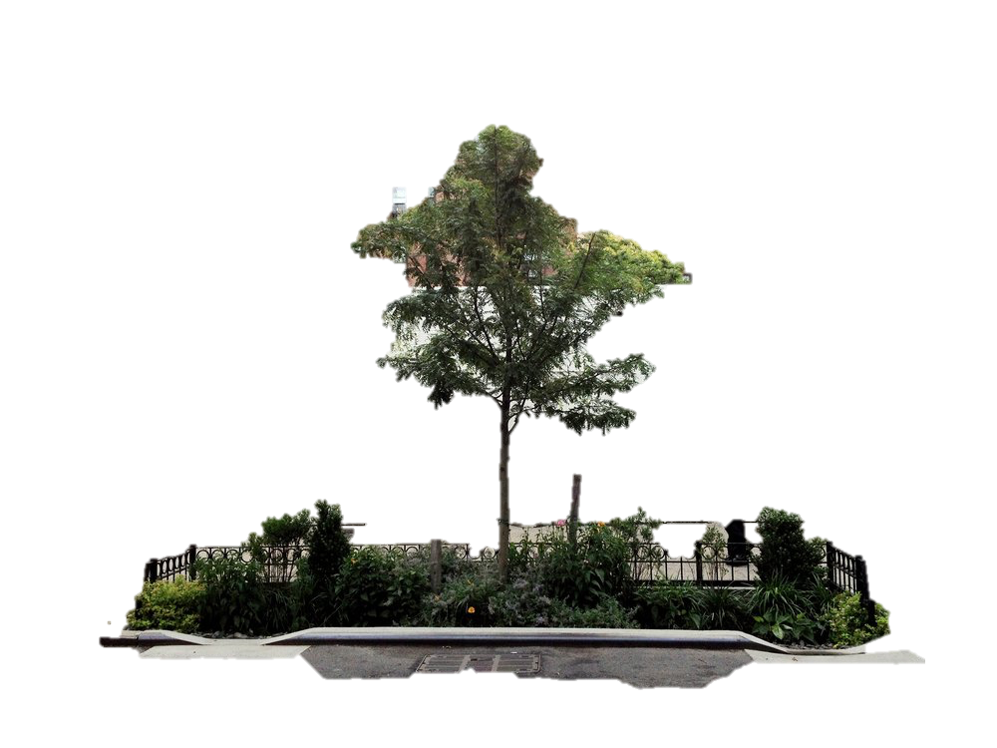
Node 1
14403 Linwood
Commercial Redevelopment
DDF Late Stage Pre-Development Loan for environmental remediation
Michigan Good Food Fund for construction and equipment

Slide 19
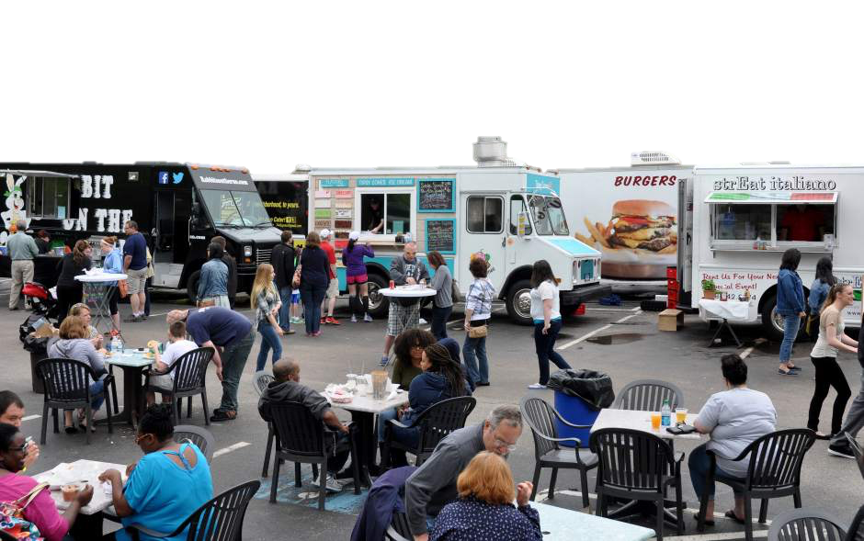
Node 1
1591 Oakman
Permanent seating
Food trucks at designated times
GSI linked to Focused Hands Garden

Slide 20
Node #1:
Linwood at
Oakman
Privately Owned
Commercial Redevelopment or Support
Green Stormwater Infrastructure & Temporary Activation
Green Stormwater Infrastructure & Temporary Activation

Slide 21
Node #1:
Linwood at
Oakman
Privately Owned
Commercial Redevelopment or Support
Green Stormwater Infrastructure & Temporary Activation
Green Stormwater Infrastructure & Temporary Activation

Slide 22
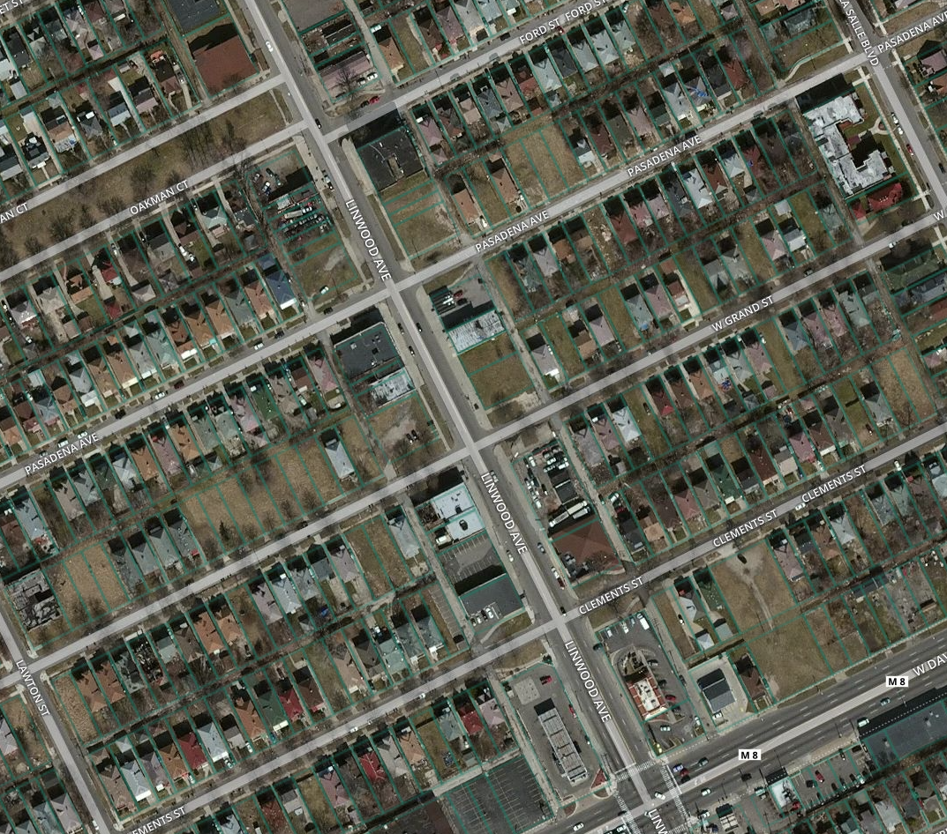
Node #2:
Linwood, Ford to Clements
Privately Owned
Privately Owned – Foreclosed or Delinquent
City Owned
Focus: Hope Owned
Davison

Slide 23
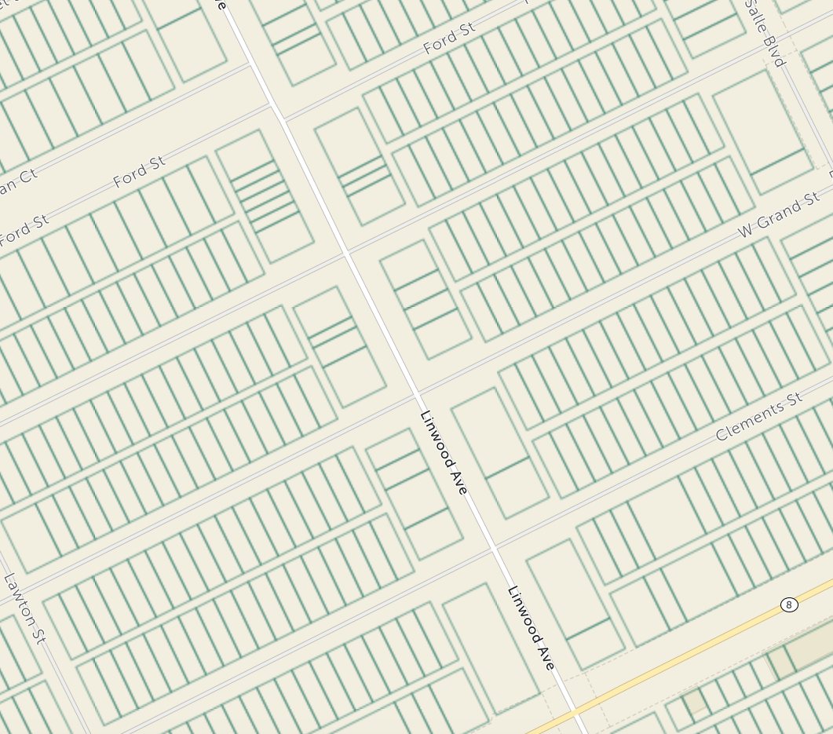
Node #2:
Linwood, Ford to Clements
Privately Owned
Privately Owned – Foreclosed or Delinquent
City Owned
Focus: Hope Owned
Davison

Slide 24
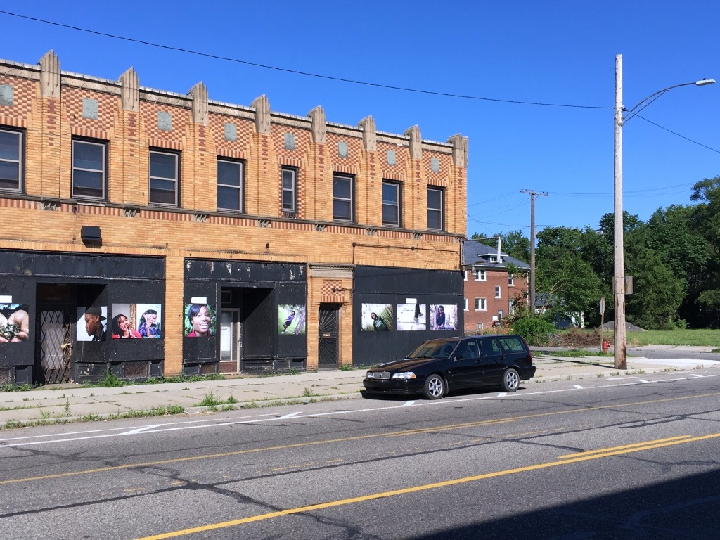
Node #2
13731 Linwood

Slide 25
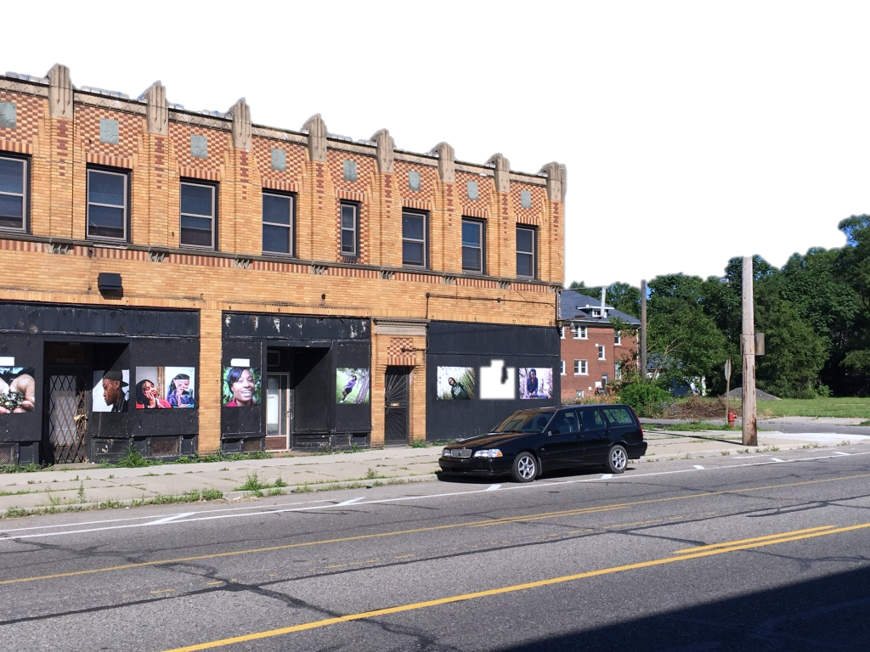
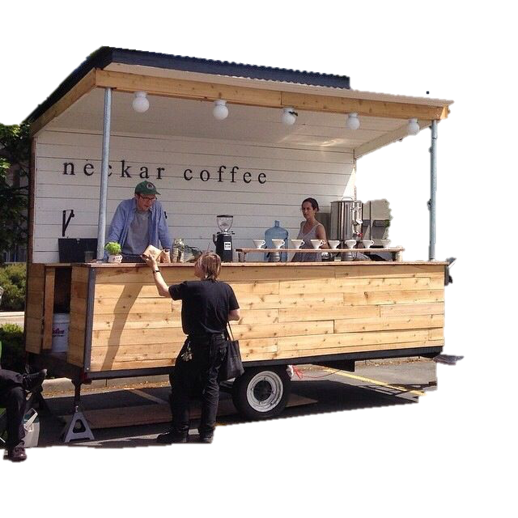
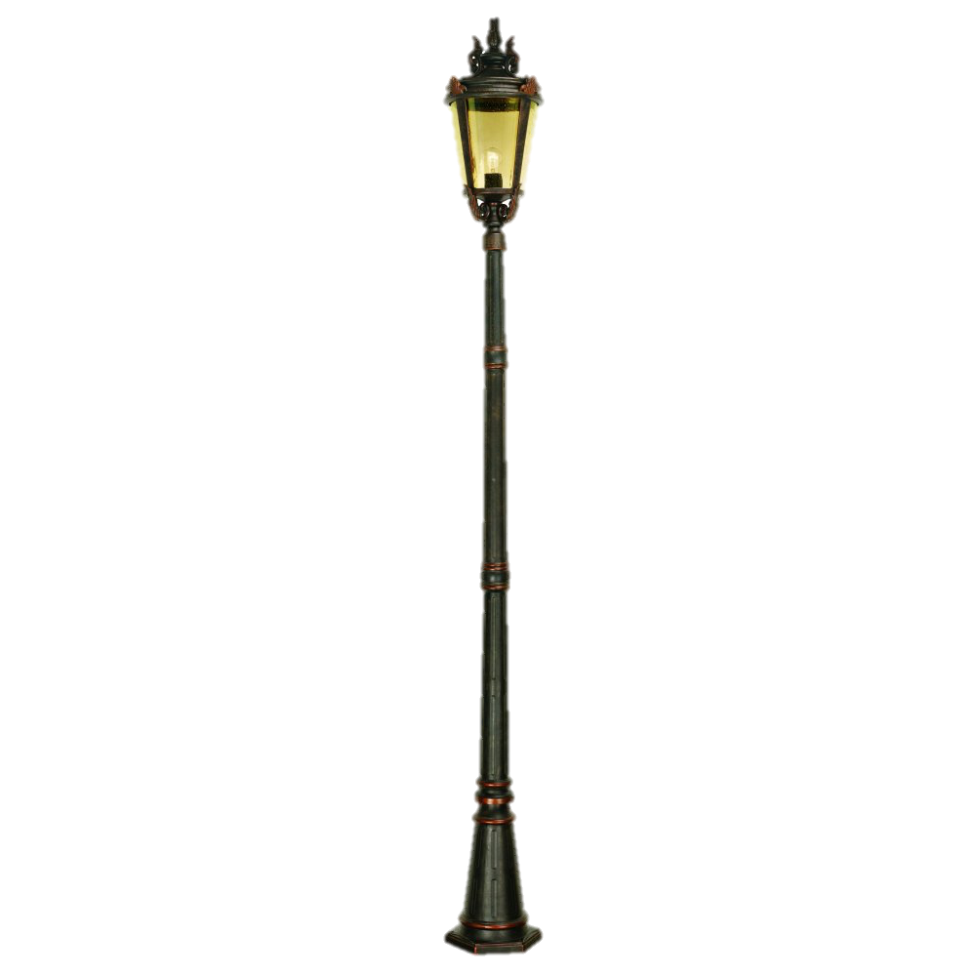
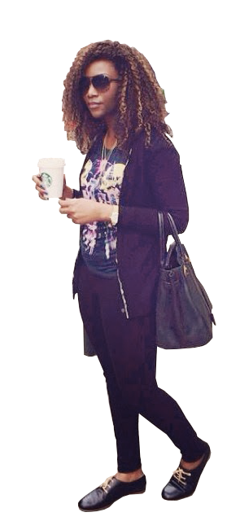
Node #2
13731 Linwood
Commercial Redevelopment
Mixed-use, ProsperUs graduates on ground floor, office on second
Michigan Opportunity Resource Fund to fund
Historic Tax Incentives

Slide 26
Node #2:
Linwood, Ford to Clements
Privately Owned
Commercial Redevelopment & Support
Green Stormwater Infrastructure & Temporary activation
Green Stormwater Infrastructure & Temporary activation

Slide 27
Node #2:
Linwood, Ford to Clements
Privately Owned
Privately Owned – Foreclosed or Delinquent
City Owned
Focus: Hope Owned
Davison

Slide 28
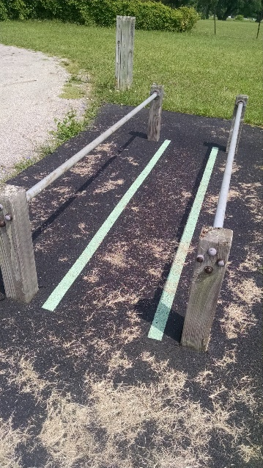
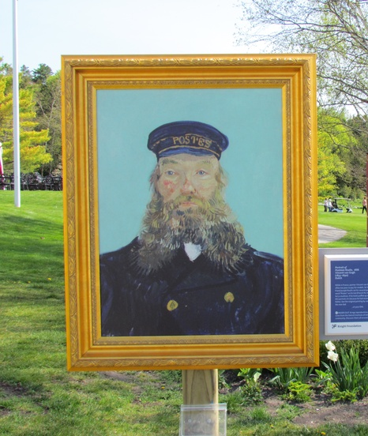
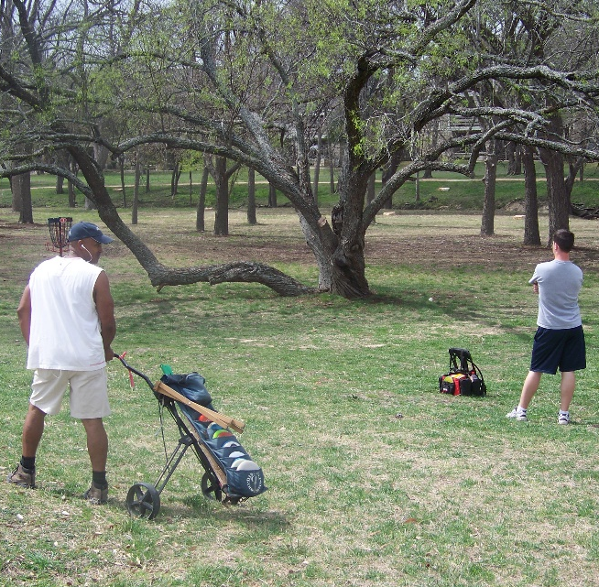
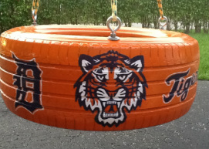
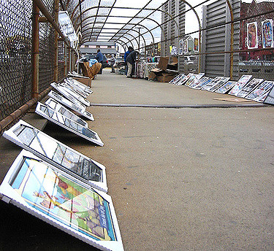
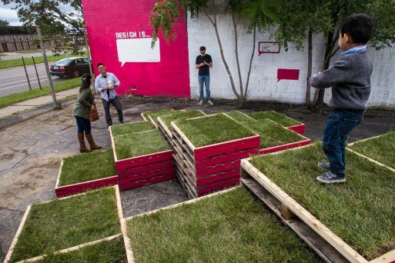
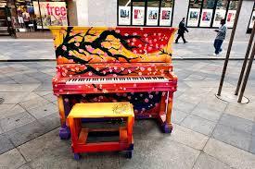
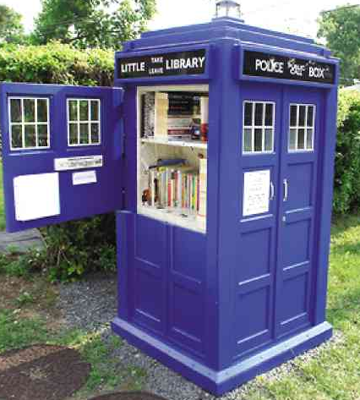
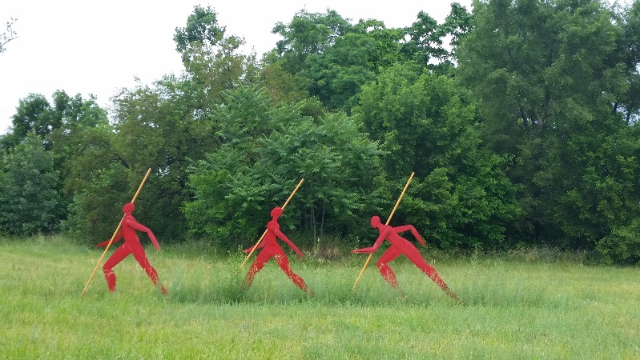
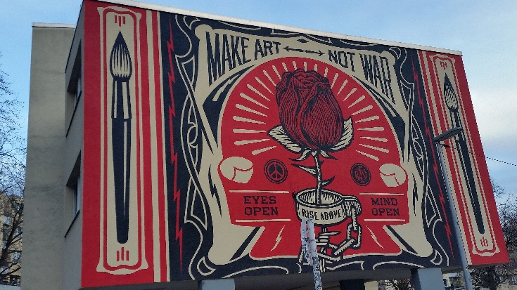
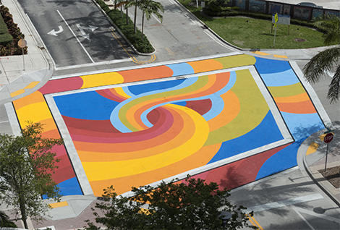
Tactical Urbanism: Strategies for Temporary Activation
Pictures:
Statues
Street pianos
Performers
Little free libraries
Mobile vendors
Murals and DIA inside out
Non electric exercise equipment
Human sized games
Decorative cross walks
Ice Sculptures
Notes:
https://www.google.com/url?sa=i&rct=j&q=&esrc=s&source=images&cd=&cad=rja&uact=8&ved=0ahUKEwi3qfapvafVAhUK4YMKHS8GDQ0QjRwIBw&url=http%3A%2F%2Fwww.boredpanda.com%2Fstreet-pianos-play-me-im-yours-project-luke-jarram%2F&psig=AFQjCNFuwH0BfC6eOaGpOEcpIPvvX10dZw&ust=1501176750573886 - piano
https://www.google.com/url?sa=i&rct=j&q=&esrc=s&source=images&cd=&cad=rja&uact=8&ved=0ahUKEwiop43UvqfVAhWh7YMKHYQlCEoQjRwIBw&url=http%3A%2F%2Fwww.fortlauderdale.gov%2Fdepartments%2Ftransportation-and-mobility%2Ftransportation-division%2Fbuilding-community-today%2Fpainted-intersections-project&psig=AFQjCNFZZpuGCevksK2cYmkrf00D6H_1Fg&ust=1501176926840357 - cross walk
https://www.google.com/url?sa=i&rct=j&q=&esrc=s&source=images&cd=&cad=rja&uact=8&ved=0ahUKEwi2nIbqvafVAhVD64MKHShZD1AQjRwIBw&url=http%3A%2F%2Fwww.cnchess.com%2Fen%2Fgarden_chess_piece.html&psig=AFQjCNGJFgL75ema2fjlaGMuGVJ2LzgQxA&ust=1501176872489009 -chess piece
Dabls - https://www.flickr.com/photos/mbadmuseum/3975536277/sizes/z/
Highline popsicle stand - http://www.glenwoodnyc.com/manhattan-living/wp-content/uploads/2011/06/5-high-line-2-la-newyorkina-popscicles.jpg
Woodbridge library - http://newsinfo.inquirer.net/files/2015/01/L0127LFL-1.jpg
Dia inside out - https://s-media-cache-ak0.pinimg.com/736x/ea/84/34/ea8434872277306b4d57e2ad0ae4bc89.jpg
DDF Photo- drinks by design fb image

Slide 29
Nodes
Parkman Library
Connections

Slide 30
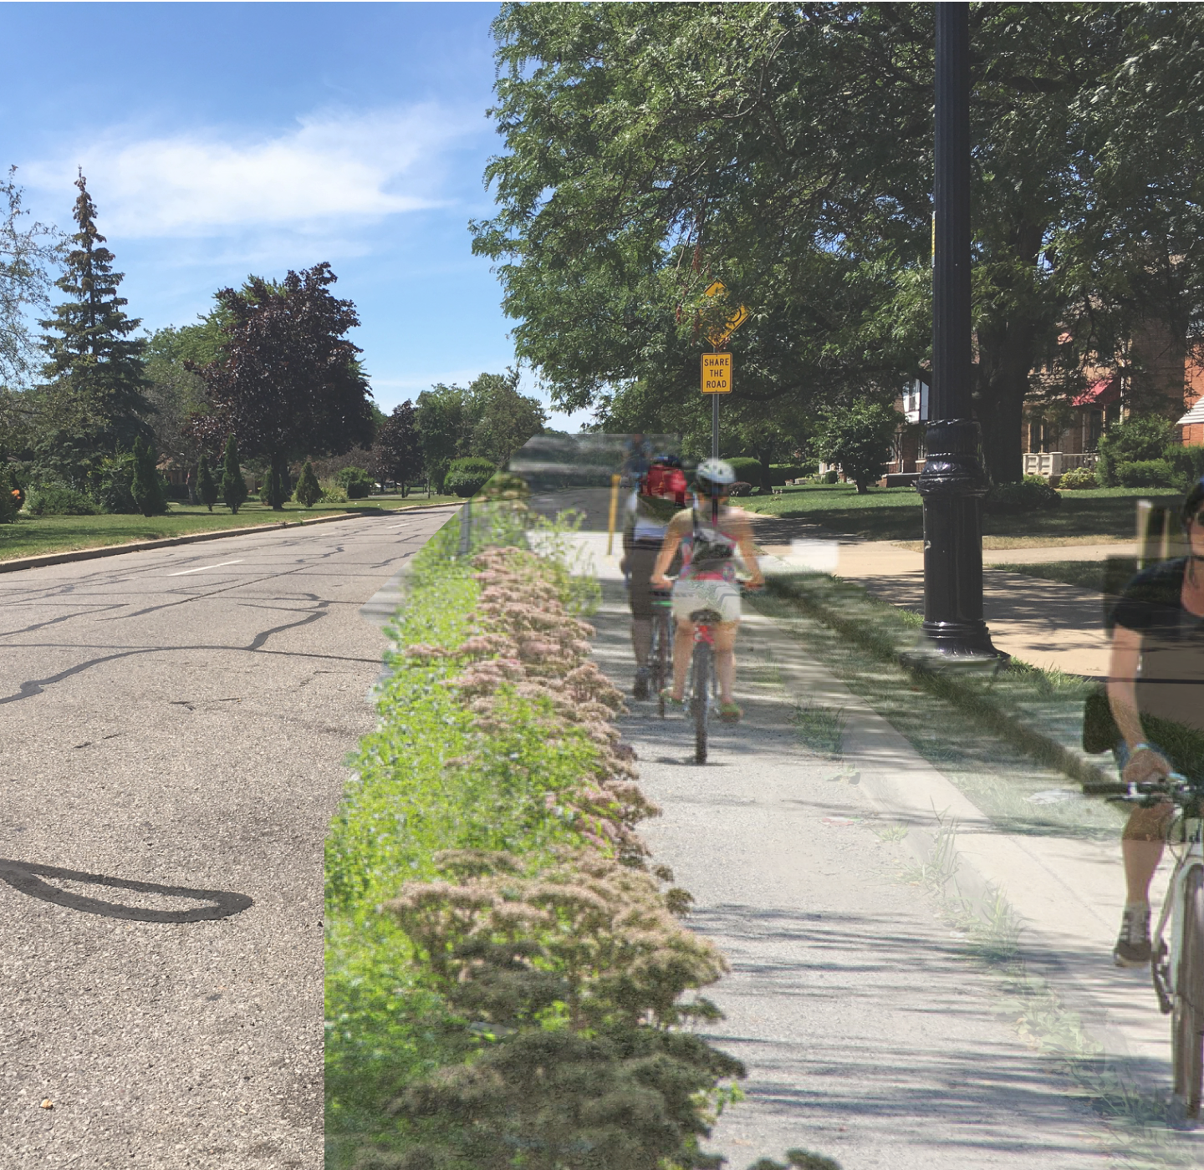
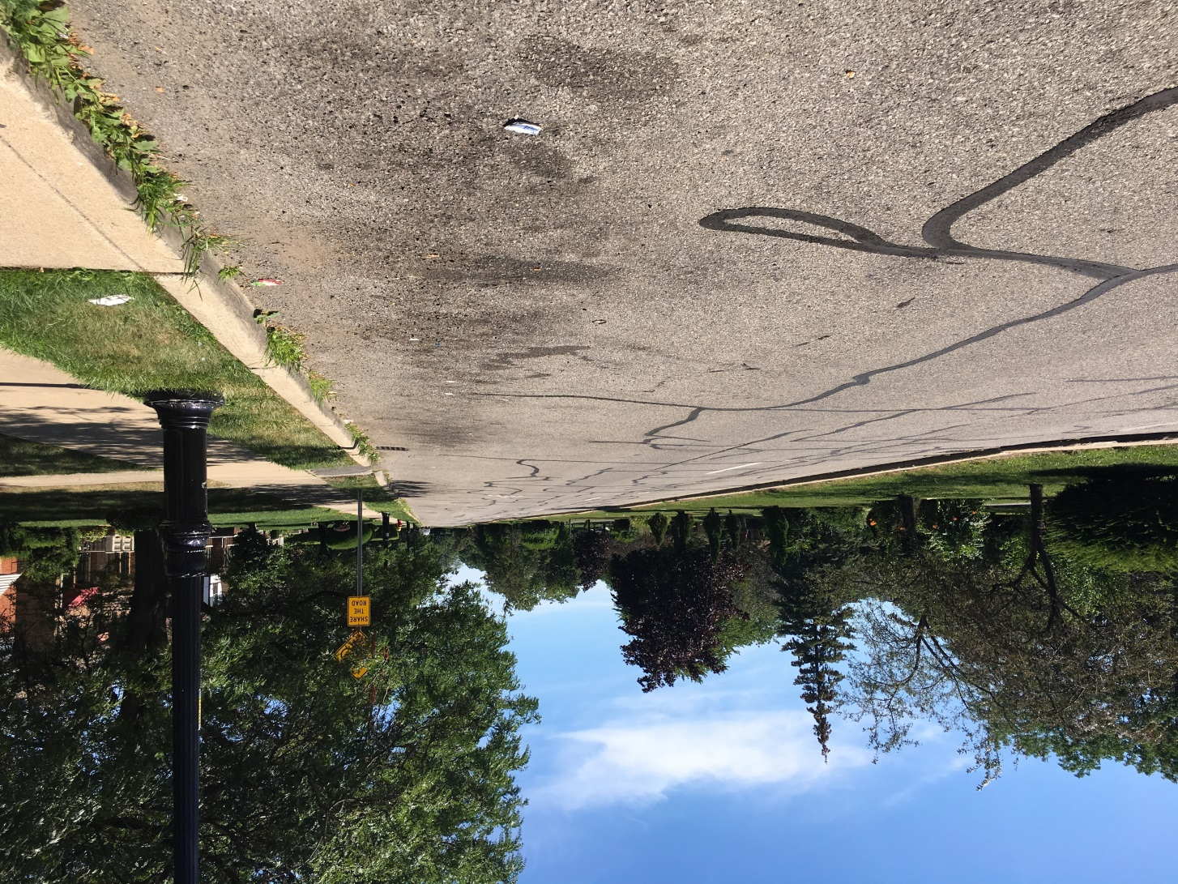
Bike Infrastructure
Oakman: West of Linwood

Slide 31
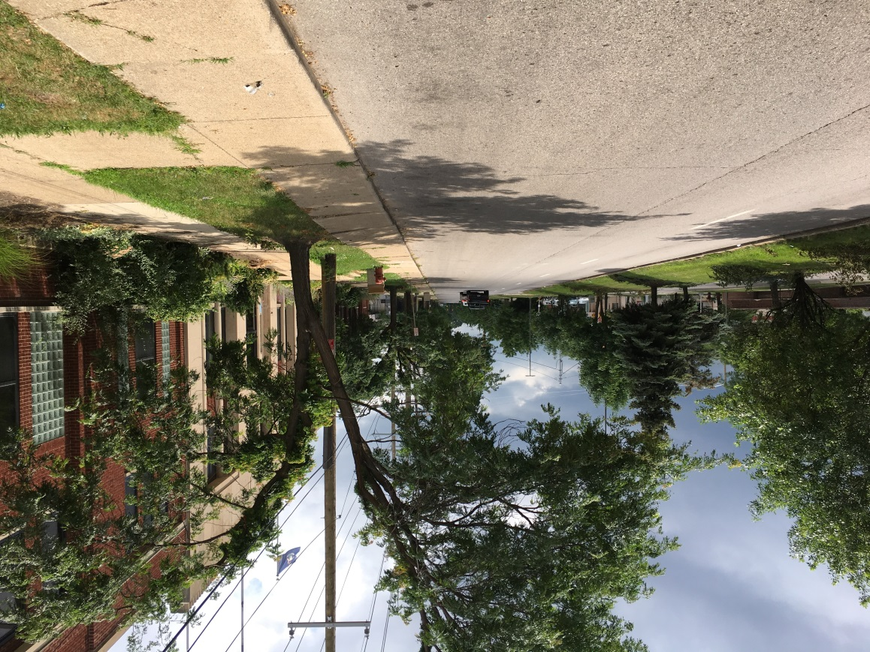
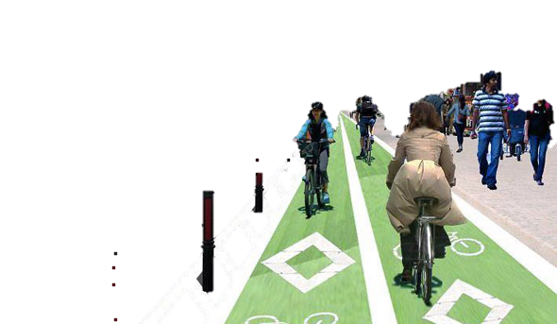
Bike Infrastructure
Oakman: East of Linwood

Slide 32
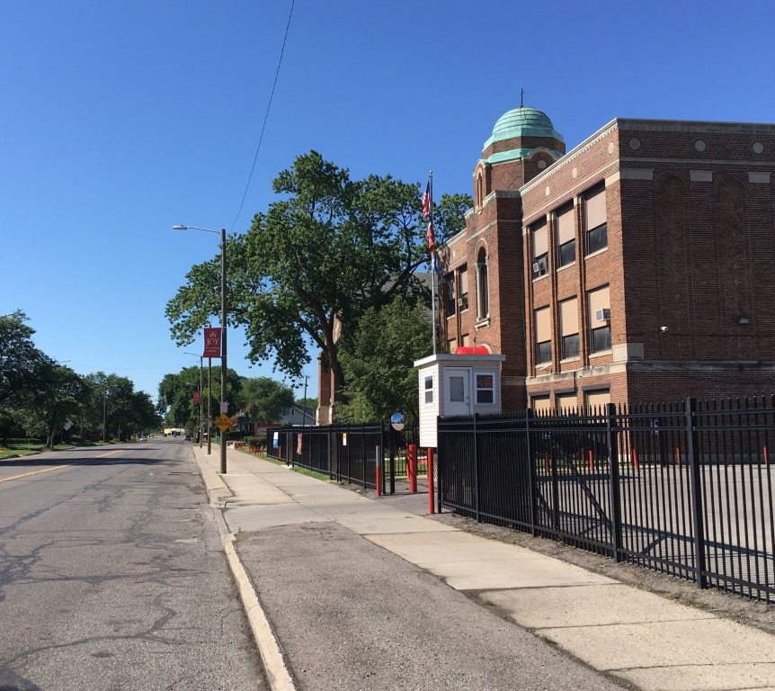
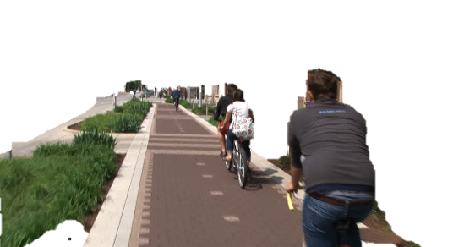
GSI & Bike Infrastructure
Dexter

Slide 33
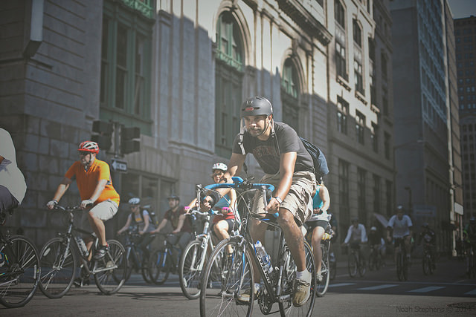
Historic Bicycle Tours
Inspiration
Tour-de-Troit
Wheelhouse Detroit
Motor City Brew Tours
Photo from Tour-de-Troit, courtesy of Noah Stevens, https://www.flickr.com/photos/tour-de-troit/15158413509/in/photostream/
Notes:
Historic bike tours have become a popular pastime in Detroit, especially over the last few years. They are a great way to open up a neighborhood to newcomers, as well as acquainting visitors and residents with points of interest that are both cultural and historic in nature, that they may not have known about. As the Greenway would go right through Hope Village, we felt a bike tour would be a great way to bring riders off the path and into the neighborhood to experience some of its history, and possibly make a few stops at shops and restaurant along the way.

Slide 34
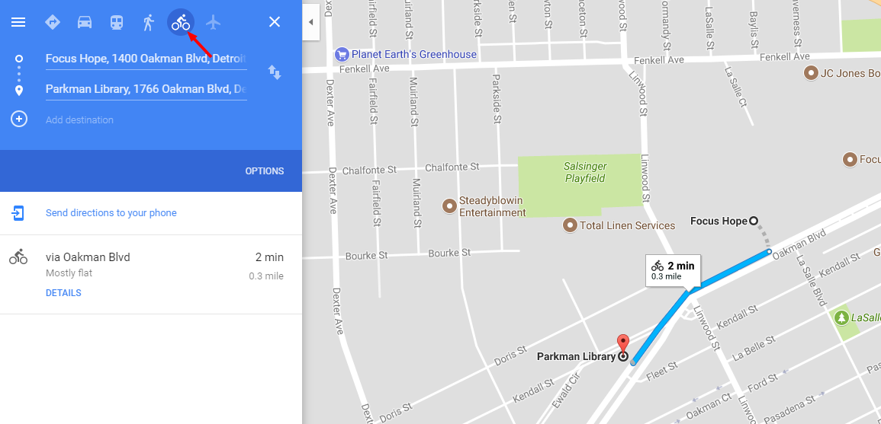
Recommendations
Partner with Parkman Library
Create wayfinding to guide riders off the Greenway and into Hope Village, towards the library
Riders may pick up maps and guides that will help them find paths through historic neighborhoods, as well as towards local restaurants and shops.
Simple bike path via Google Maps, Bicycle Touring Pro recommends using Google Earth to create paths that would look similar – Screenshot: Natasha Rivera, using Screenshot Capture. Recommendation: http://bicycletouringpro.com/how-to-plan-a-safe-and-enjoyable-bicycle-touring-route/
Notes:
A good way to start this is to look at inspiration from existing and successful bike tours, such as Wheelhouse Detroit and Tour-de-Troit. In this case, a starting point for riders could be the Parkman Library, a great landmark and gathering place in Hope Village. Here, riders could pick up maps and guides that will lead them through historic districts, like Oakman Boulevard and Ewald Circle, and towards areas that have cultural significance, like the Detroit Repertory Theater. Creating these guides is not complex, though it would require the assistance and support of both residents of the neighborhood and experts in mapping or guide making.

Slide 35
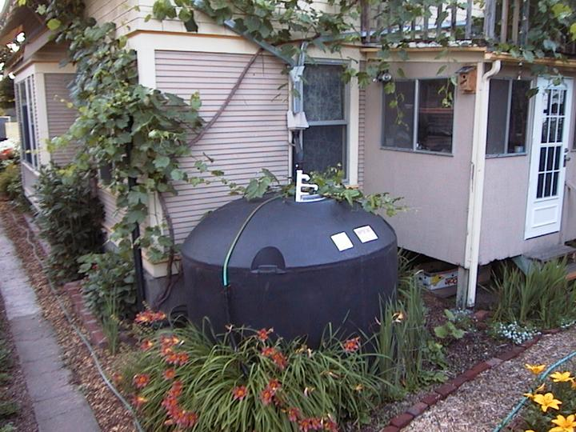
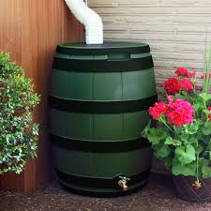
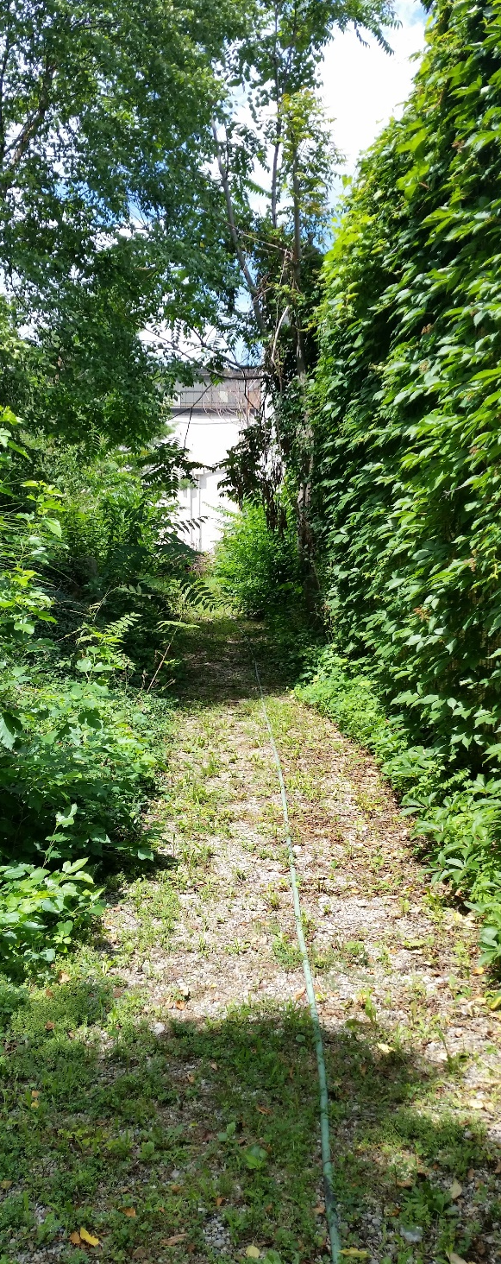
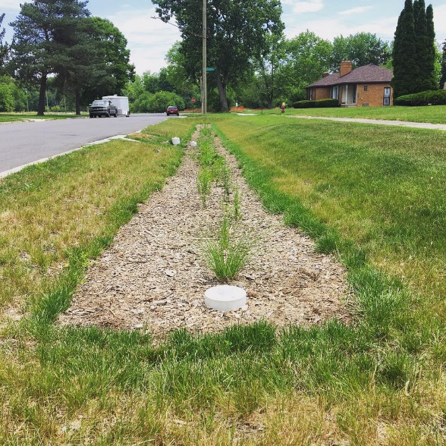
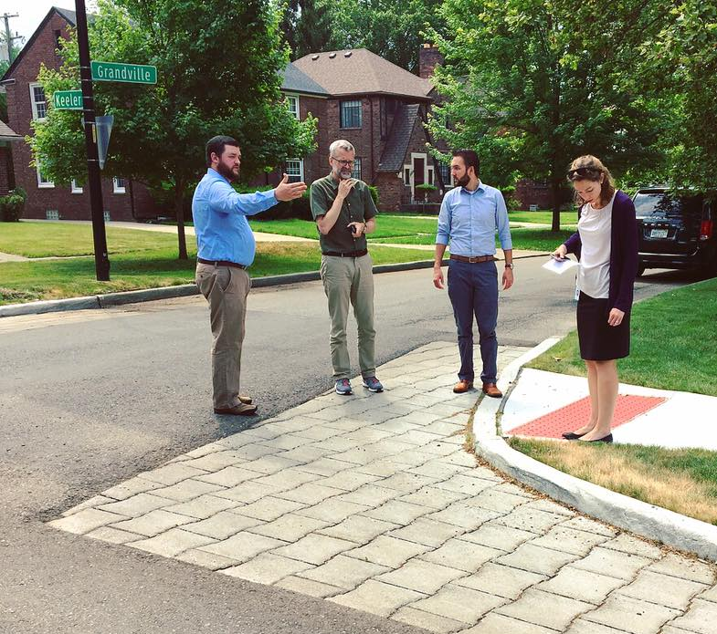
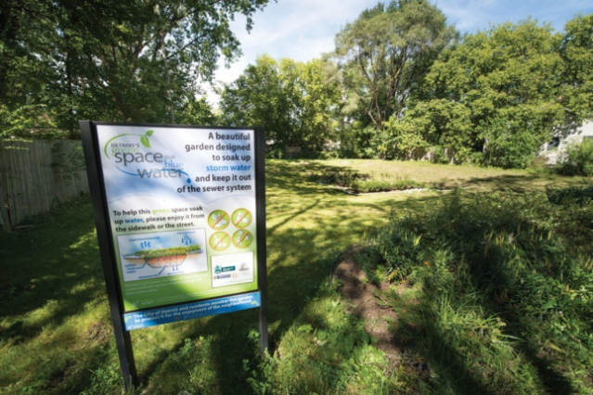
Green Stormwater Infrastructure
Pictures:
Bioswales
Rainbarrels
Cisterns
Permeable pavers
Green alleys
Notes:
https://www.google.com/imgres?imgurl=http%3A%2F%2Fwww.glacvcd.org%2Fwp-content%2Fuploads%2F2016%2F01%2Frain-barrel.jpg&imgrefurl=https%3A%2F%2Fwww.glacvcd.org%2F2016%2F01%2Fhow-keep-mosquitoes-out-of-rain-
https://www.google.com/imgres?imgurl=http%3A%2F%2Fwww.lid-stormwater.net%2Fimages%2Fcistern12.jpg&imgrefurl=http%3A%2F%2Fwww.lid-stormwater.net%2Fraincist_benefits.htm&docid=28VoztX08xyU4M&tbnid=lrEgOP_tZHQsEM%3A&vet=10ahUKEwjW6Jf1yKfVAhXphVQKHeW9D3wQMwjZAigSMBI..i&w=720&h=540&bih=662&biw=1366&q=cisterns&ved=0ahUKEwjW6Jf1yKfVAhXphVQKHeW9D3wQMwjZAigSMBI&iact=mrc&uact=8
barrels%2F&docid=uajhfUt5OVor9M&tbnid=5HMRrT9LE2XY8M%3A&vet=10ahUKEwjM4YfoyKfVAhVrzVQKHeBpAe0QMwjCAigBMAE..i&w=1500&h=1500&bih=662&biw=1366&q=rain%20barrel&ved=0ahUKEwjM4YfoyKfVAhVrzVQKHeBpAe0QMwjCAigBMAE&iact=mrc&uact=8
DFC website
http://archpaper.com/wp-content/uploads/2016/11/NassauerbioretentionSign-645x430.jpg

Slide 36
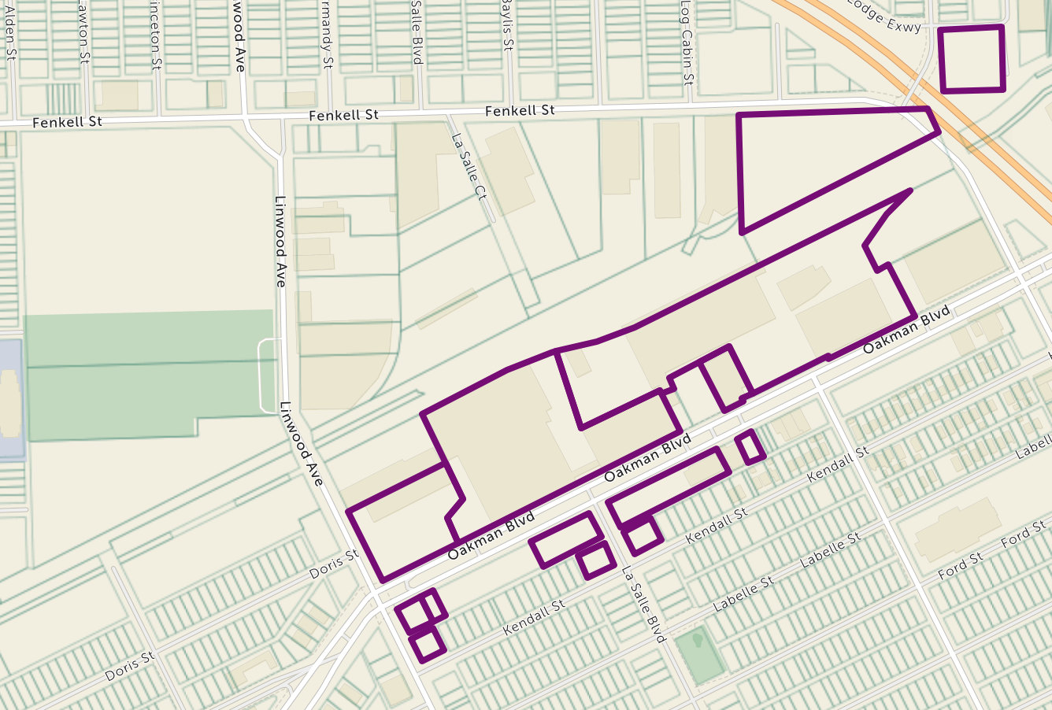
GSI on the ICG
Focus: Hope & City Property
City Owned
Focus: Hope Owned

Slide 37
GSI Opportunity Sites
Implement GSI strategies in City-owned and Focus: Hope owned lots
Utilize access to existing green space along the ICG
Reduce impervious surface in parking lots on Focus: Hope campus

Slide 38
1200 Oakman
Curbside Bioswale
Incorporate credits for drainage of right away
Utilize $50,000 match from City of Detroit fund

Slide 39
1200 Oakman
Reduce Impervious surface area
Transform visible identity of unadorned building

Slide 40
1200 Oakman

Slide 41
1200 Oakman
Mid-lot Bioswale
Permeable pavement
Reduce Impervious surface area
Earn Credits for reducing both volume and peak flow

Slide 42
Eco-D Zoning Overlay
An overlay zone is a zoning tool that specifies additional criteria or standards over one or more previously established zoning districts.
Overlay zones are geographically specific and are often used to address special land use conditions.
Overlay zones are frequently used to superimpose special environmental safeguards to protect sensitive resources, establish standards for preserving historic resources within a district, or promote desired development types within a designated area.

Slide 43
What is in the Eco-D Zoning Overlay?
Parking Lot Landscaping Requirements
Permeable Surfaces
Bioswales and Rain Gardens
Urban Prairies and Forest
Waste
Restricted Uses

Slide 44
Tax Increment Financing
Current Brownfield TIF District
Tax Increment Financing can be utilized to fund GSI
Installing GSI increases sustainability, meets goals of the Eco-D
GSI decreases costs of drainage fees and is vital for economic sustainability

Slide 45
Proposed TIF
Current TIF
New TIF District
Include Focus Hope properties on Oakman
Include Salsinger Playground and adjacent City-owned properties
Include Linwood Commercial Corridor
Funding GSI on Focus: HOPE properties
Facilitate environmental remediation Provide Capital for Commercial redevelopment in nodes and along corridors.

